Slide 1


Surveying the Signaling Landscape by Transcriptome Profiling in Mitochondrial Disease
Jim Zhe Zhang, PhD.
Department of Biomedical and Health Informatics
The Children’s Hospital of Philadelphia

Slide 2
Studies of transcriptomes of mitochondrial diseases
A short review of bioinformatics techniques
The big data challenge
Demo: Awsomics toolbox and the ToMD data collection

Slide 3
What we talk about when we are talking about transcriptome
RNA classes: mRNA, miRNA, lncRNA, pre-mRNA, …
RNA dynamics: splicing, editing, degradation, translation, …
Differential expression: tissues, diseases, conditions, …
Regulation and interaction: genome, epigenome, metabolome, proteome, …

Slide 4
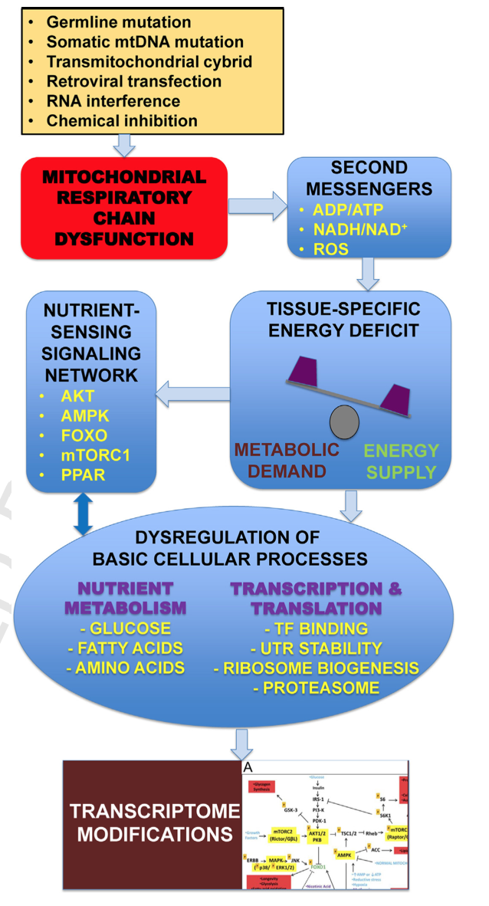
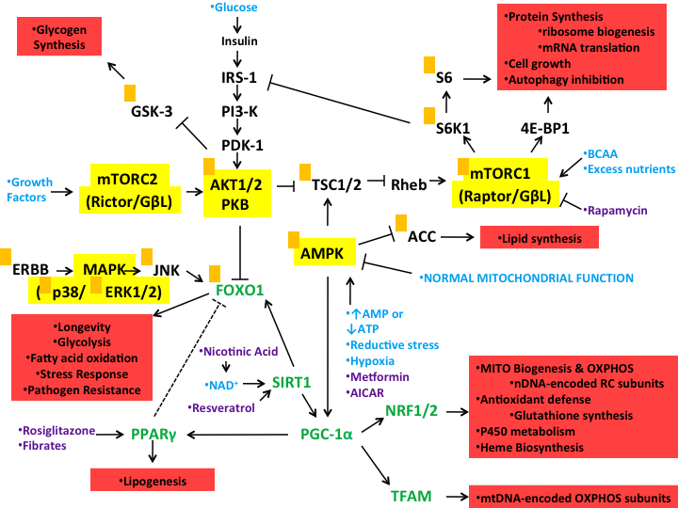
Mitochondrial RC dysfunctions ⬇ Transcriptome modifications
Nutrient-sensing signaling network (NSSN)
Tissue-specific
transcriptome
modifications

Slide 5
Transcriptomic profiling of primary RC dysfunctions
Animal models
Induced genetic mutations of RC complex subunits
Chemical perturbation (e.g. rotenone and oligomycin)
Restore RC functions with drugs (e.g. Probucol)
Primary RC diseases
Patients carrying known mutations affecting RC functions (MELAS, ATP synthase deficiency, mtDNA m.3243A>G)
Different cell types: muscle biopsy, skin, blood, …
A common mechanism lead to transcriptome modifications?

Slide 6
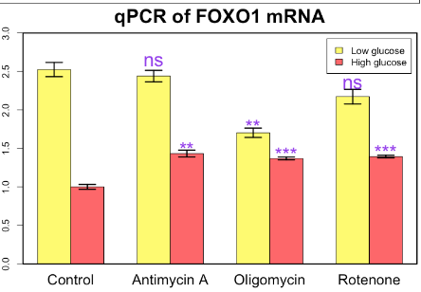
Evidences supporting the involvement of NSSN
The transcriptomes of muscle and skin cells from a heterogeneous group of patients with known RC enzyme deficiency
RHEB, a direct mediator of mTORC1 activity, is one of the most significantly changed genes across patients and tissue-type
Target genes of FOXO1 and PPARs, regulators of lipid metabolism, were concordantly affected
Transcription of cytosolic and mitochondrial ribosomal proteins was changed towards different directions, suggestive of a re-balance of protein translation
Global transcriptome modifications were completely reversed in muscle and skin cells
In vitro experiments showed dependence
Of drug response on nutrient supply

Slide 7
Studies of transcriptomes of mitochondrial diseases
A short review of bioinformatics techniques
The big data challenge
Demo: Awsomics toolbox and the ToMD data collection

Slide 8
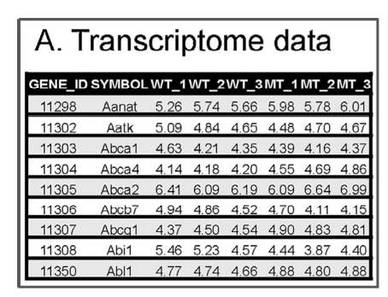
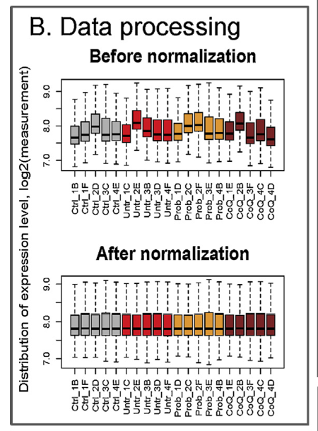
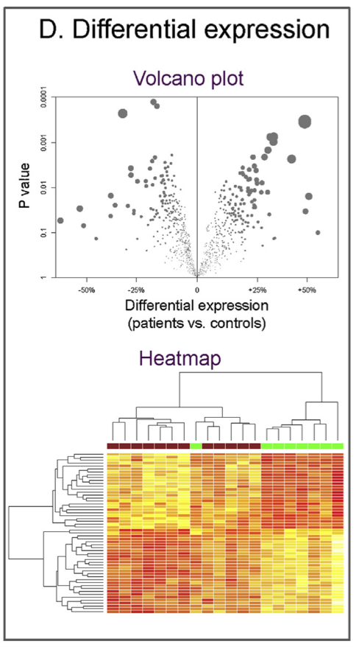
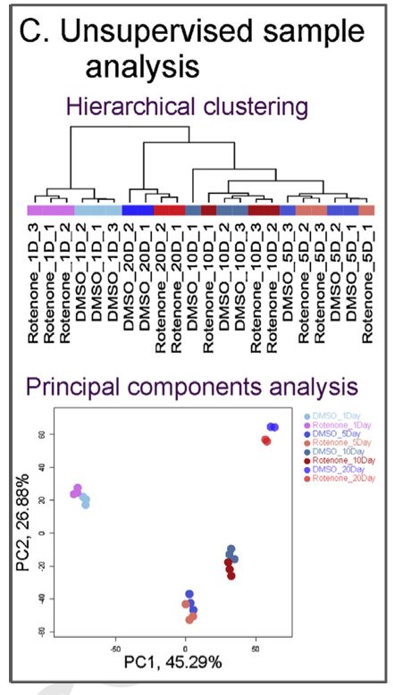
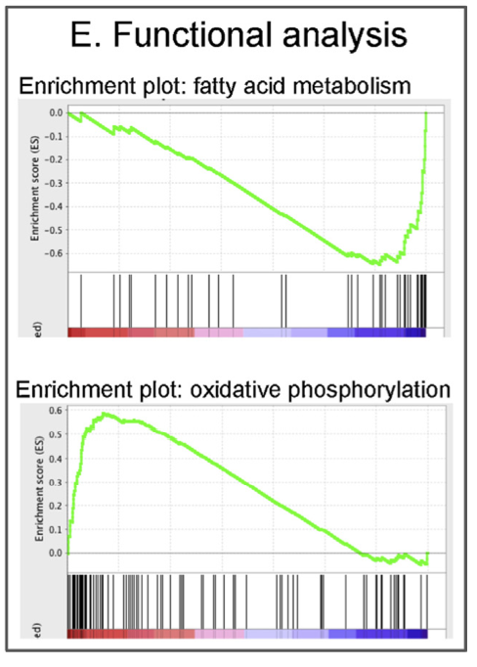
A typical workflow of analyzing transcriptome data sets

Slide 9
GSEA enrichment plot
N2 vs. Gas1
Running enrichment score
Genes in pathway
Ranking of all genes

Slide 10
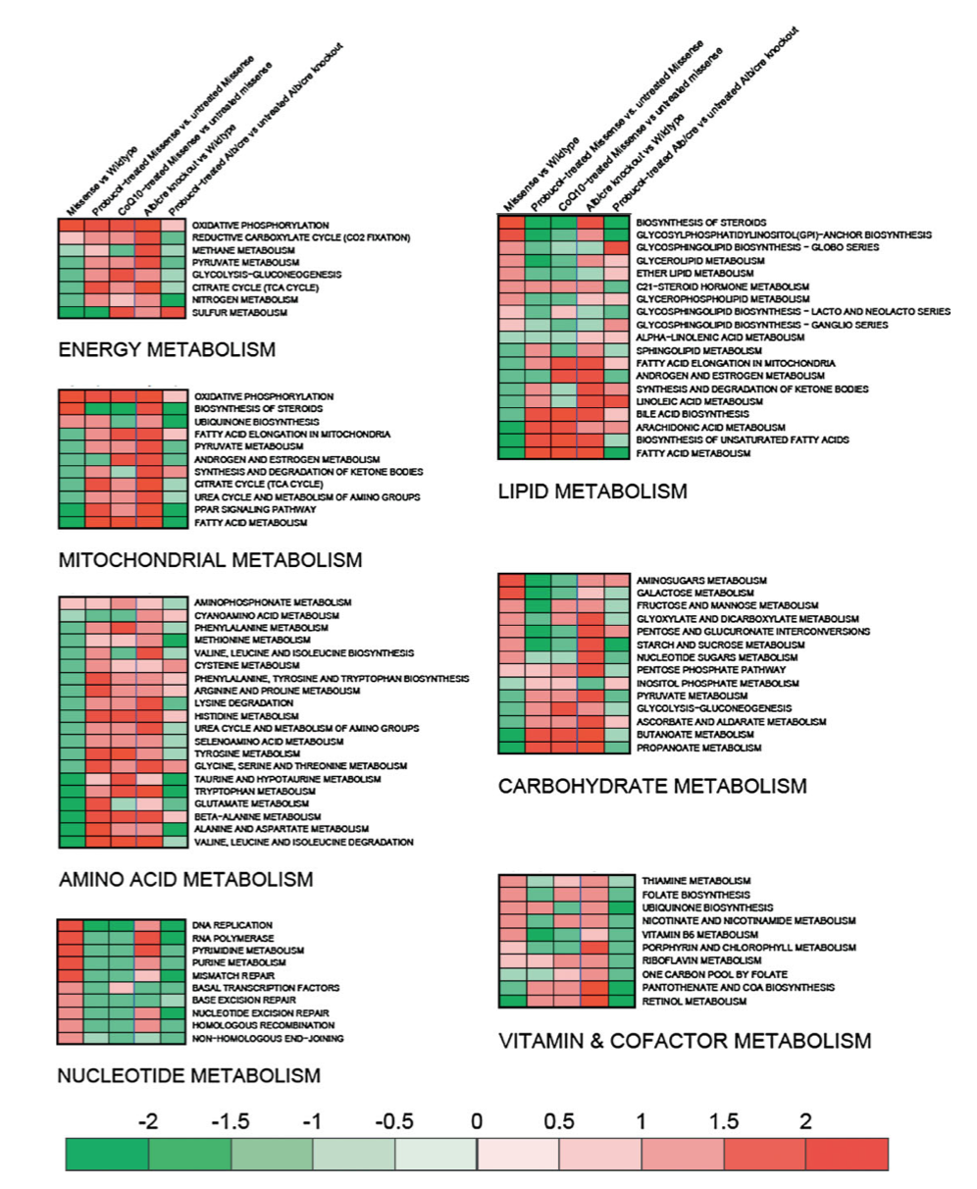
A global view of differential expression of metabolic pathways
Pdss2 missense mutants vs. wild type
Probucol treated vs. untreated mutants
Further group metabolic pathways

Slide 11
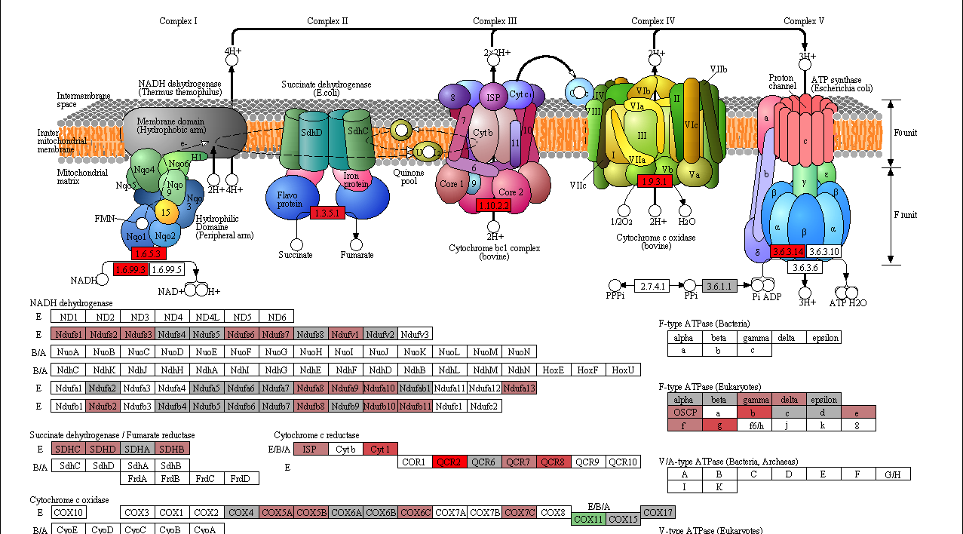
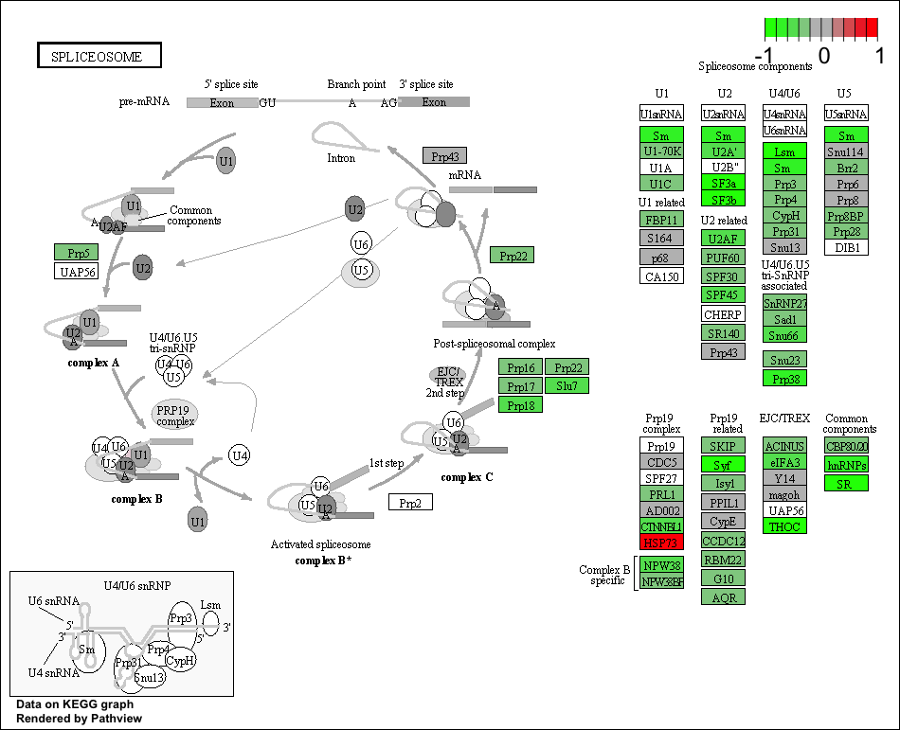
More pathway illustrations

Slide 12
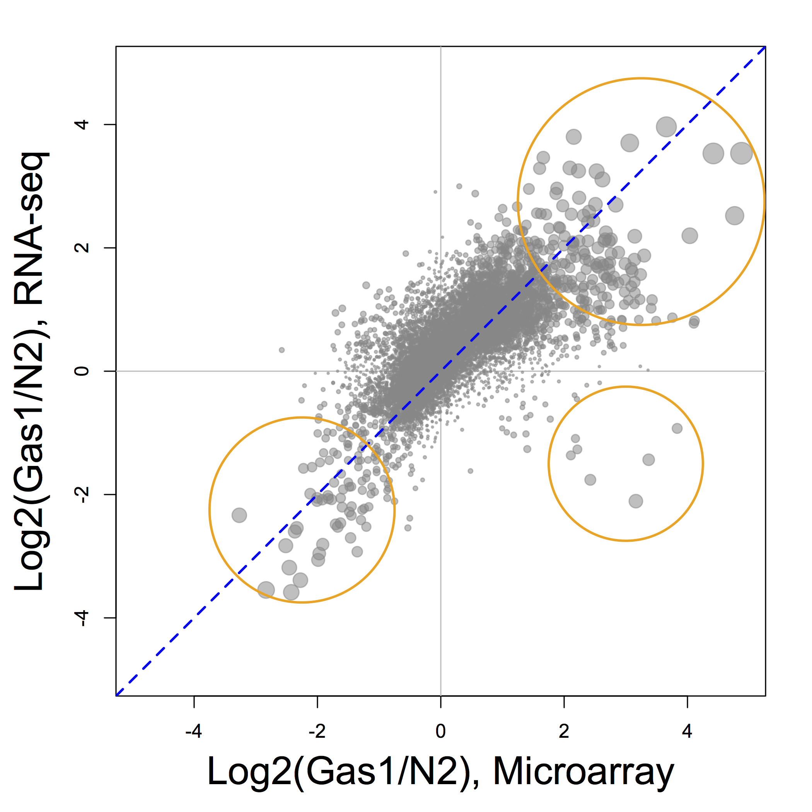
RNA-seq vs. Microarray
Gene level differential expression
Corr = 0.65
N2 < Gas1
N2 > Gas1

Slide 13
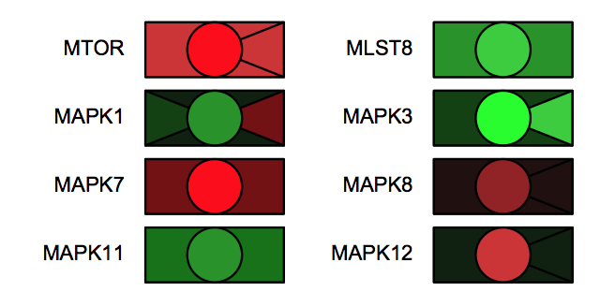
Analysis beyond coding RNAs
Sense vs. antisense transcripts
UTR stability
Regulatory sequences in promoters
Region-specific differential expression

Slide 14
Studies of transcriptomes of mitochondrial diseases
A short review of bioinformatics techniques
The big data challenge
Demo: Awsomics toolbox and the ToMD data collection

Slide 15
The big data challenge/opportunity
Data generation
Information collection
Knowledge discovery

Slide 16
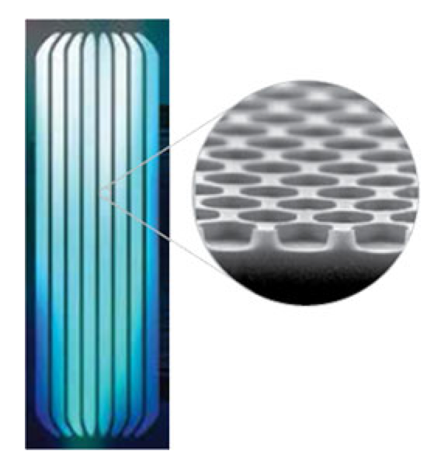

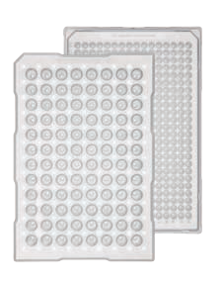
The evolution of transcriptome data
qPCR
kilobytes
Microarray
megabytes
RNA-seq
gigabytes
Bigger data vs. computational resource
Bigger data vs. turnaround time
Bigger data vs. background noise
Bigger data vs. data accessibility
Bigger data vs. knowledge discovery
Notes:
Data & information

Slide 17
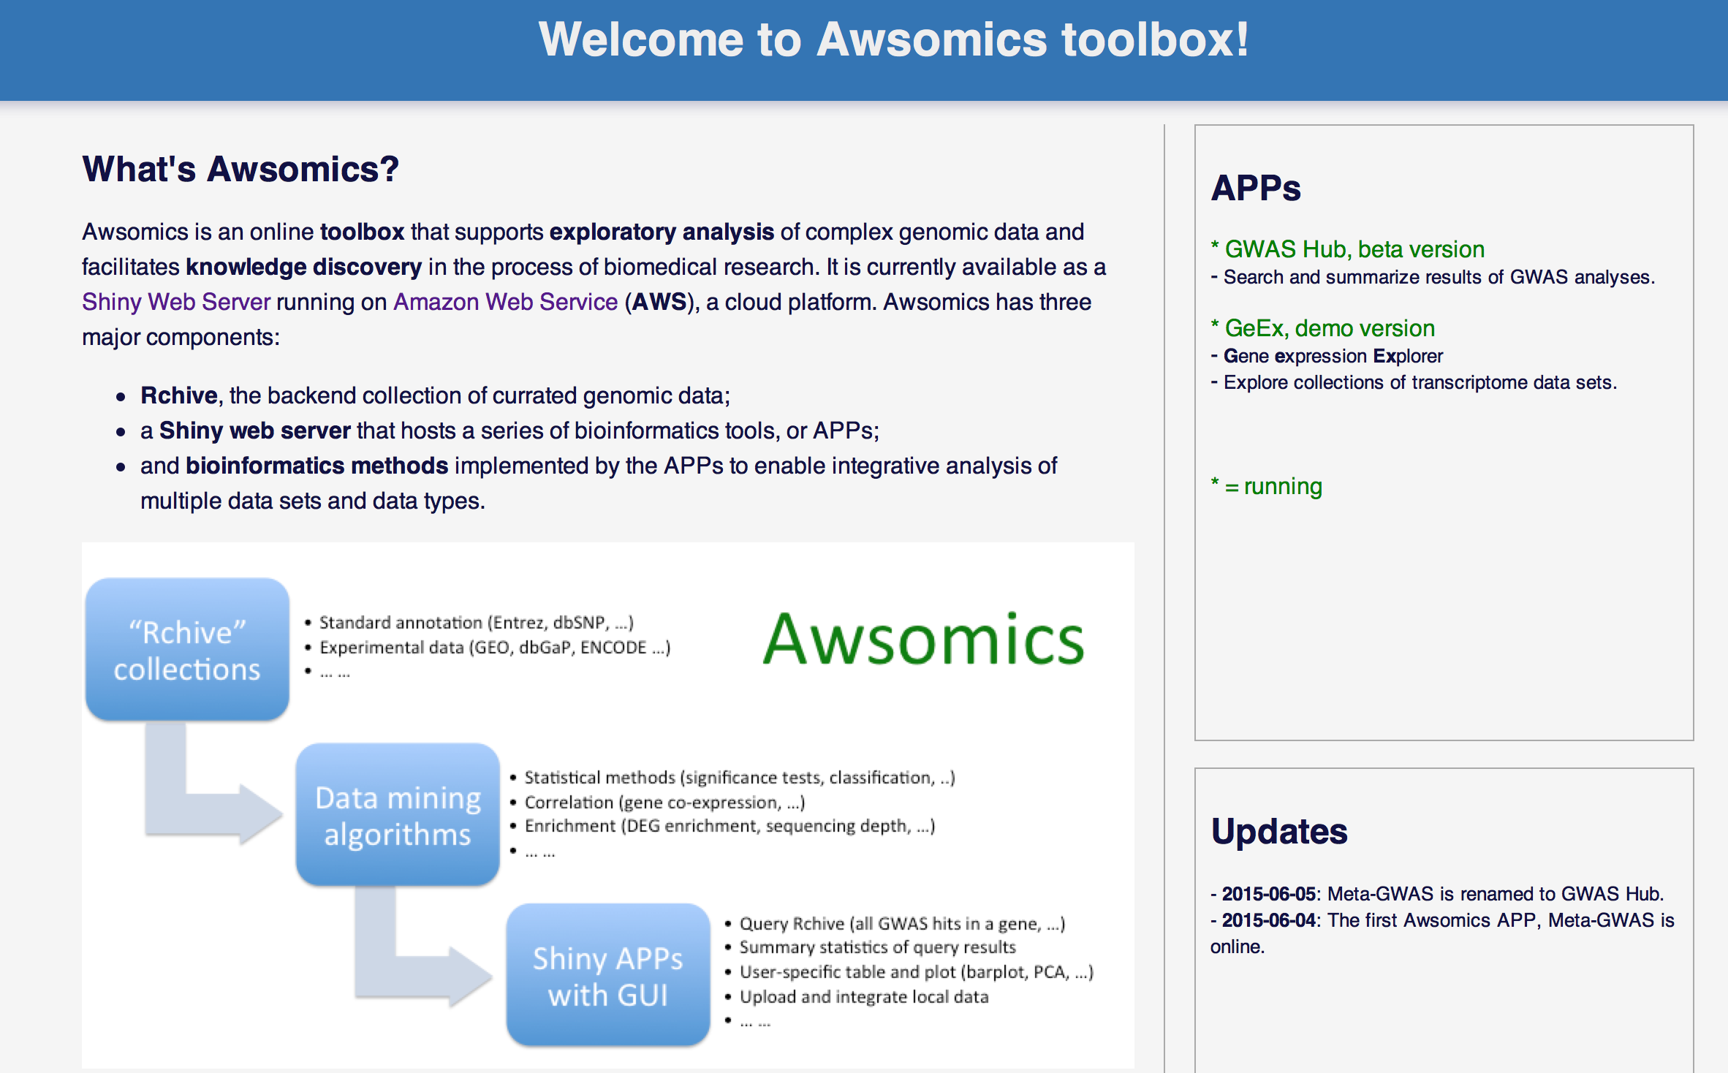
http://awsomics.org

Slide 18
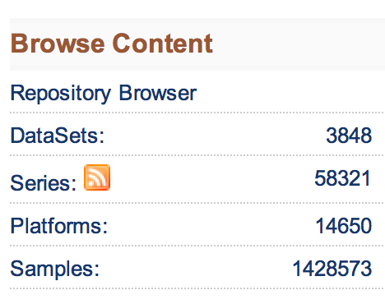
Public repositories of transcriptome data
Gene Expression Omnibus (GEO)
ArrayExpress
Gene Expression Atlas
Oncomine
ENCODE
Cancer Genome Anatomy Project (CGAP)
GEO current contents:

Slide 19
ToMD Transcriptome of Mitochondrial Dysfunctions
A curated collection of transcriptome data sets about normal/rescued vs. abnormal mitochondrial dysfunctions
35 data sets
4 species: human, mouse, fly and worm
~500 samples
>60 pairwise group comparisons
Accessible from:
MSeqDR
Awsomics : GeEx

Slide 20
A meta-analysis using ToMD
8 transcriptome data sets, 99 patients of different primary RC diseases, and 12 patient-control comparisons
Calculated a combined p values of all comparisons for each gene
Top ranked genes are highly relevant
#1 MTX2 (p = 1.8E−9), a membrane protein involved in mitochondrial protein import
#2 NGLY1 (p = 8.2E−9), a deglycosylase enzyme involved in the degradation of misfolded proteins.
Other genes: #3 MTX3, #10 LAMTOR5, #22 MFN1 (mitofusin), and several aminoacyl-tRNA synthetases

Slide 21

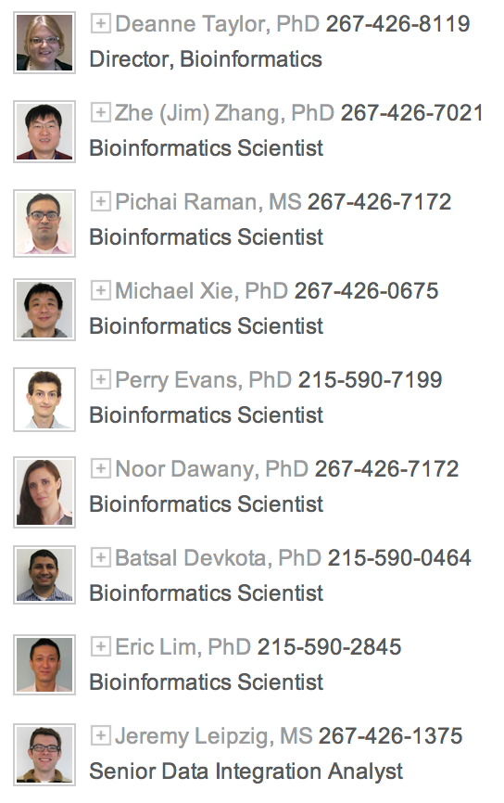
Acknowledgements
The Falk lab
The DBHI Bioinformatics group

